Slide 1
nGrinder 3.1 Feature

Slide 2
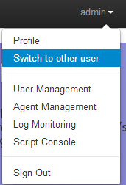
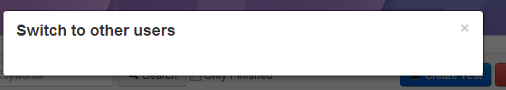
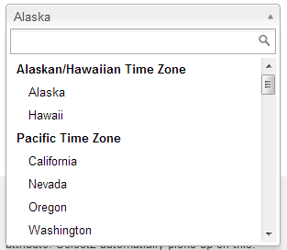
User Switch
1
Priority1
UI
Each user can switch himself to allowed others.
  There is switch to other user menu in the menu
  Then in the popup user can select one
  of the allowed users.
    Admin can switch to anyone.
    User retrieval should be ajax based
JunoYoon(kr13675)
(Display all allowed users to share)

Slide 3
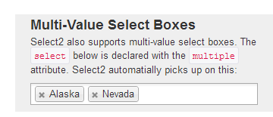
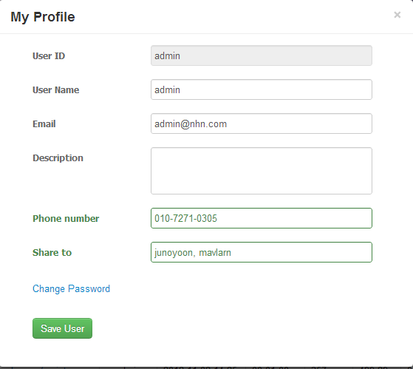

User Switch
1
Priority1
UI
Each user can allow the others to be access his account
  “Share to field” should be implemented with Multi-Value Select Boxes in Select
  Share to shows user name not user id.

Slide 4
User Switch
1
Priority1
UI
When user switch its user, it transfer its identity to the other user.
So.. Each user parameter in controller will be passed as the other user.
However each user parameter should contains what’s the real user internally.
We need User realUser field in User data type.
Then when we run the perftest we should record real user in the perftest datatype
lastModifiedUser contains original user but realUser contains real user who change this.

Slide 5
Agent Distribution
2
Priority1
We have 4 regions in which controller locating.
  Kasan, Mabok, Mockdong, nCloud
  Each location will have each own ngrinder instance connecting each own agents set
  However we need the single access point.

Slide 6



Agent Distribution
2
Priority1
controller
Mabok
Mockdong
nCloud
agents
agents
agents
service
service
service

Slide 7
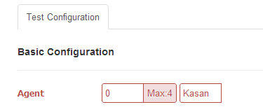
Agent Distribution
2
Priority1
We need select box when selecting Agent.
  When We select Kasan, Only kasan agents should be used for the test execution
  We need to improve agent selecting logic.

Slide 8
Controller Clustering
3
Priority2
Single Point of Failure
controller
Mabok
Mockdong
nCloud
agents
agents
agents
service
service
service

Slide 9
Controller Clustering
3
Priority2
Failure only occurs on specific controller
L4
Mabok
Mockdong
nCloud
controller
controller
전용 controller
agents
agents
agents

Slide 10
Controller Clustering
3
Priority2
Controllers share one database
Controllers share NAS for ${NGRINER_HOME}
Controllers share cache using distributed EhCache
Controllers contains each own configuration storage on
${NGRINDER_CLUSTER_HOME}
  This contains each own cluster identity.
  Like Kasan…
User can access any cluster machine but it show all same value.
Each controller handle test execution if the underlying agents are used.

